Slide 1

Smart Irrigation System with Android Integration
108118044 – Harshit Singh
108118010 – Akshat Khandelwal
108118046 – Harshwardhan Tripathi
110118010 – Anshuman Panigrahi
Notes:
5/1/2021
1
1

Slide 2
IOT Smart Irrigation - Overview
This smart agriculture using IOT system is powered by Arduino, it consists of Temperature sensor, Moisture sensor, water level sensor and DC motor.
When the IOT based agriculture monitoring system starts it checks the water level, humidity and moisture level. Sensors sense the level of water, if it goes down, it automatically starts the water pump.
If the temperature goes above the level, fan starts. This all is displayed on the Android App. This all is also seen in IOT where it shows information of Humidity, Moisture and water level with date and time, based on per minute. Temperature can be set on a particular level; it is based on the type crops cultivated. If we want to close the water forcefully on IOT there is button given from where water pump can be forcefully stopped.

Slide 3

Components required:
Arduino Uno - Atmega328p
ESP 8266
4 Channel 5V Optical Isolated Relay Module
Humidity/Temp Sensor - DHT11
Moisture Sensor
Water Motor
Water level sensor
Fans/LEDs

Slide 4
Softwares Used
Arduino IDE
Android Studio

Slide 5
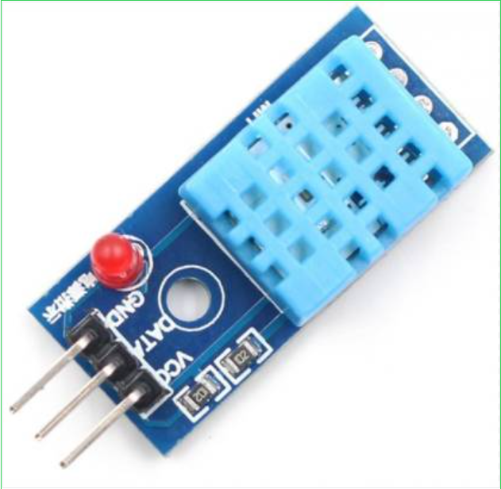
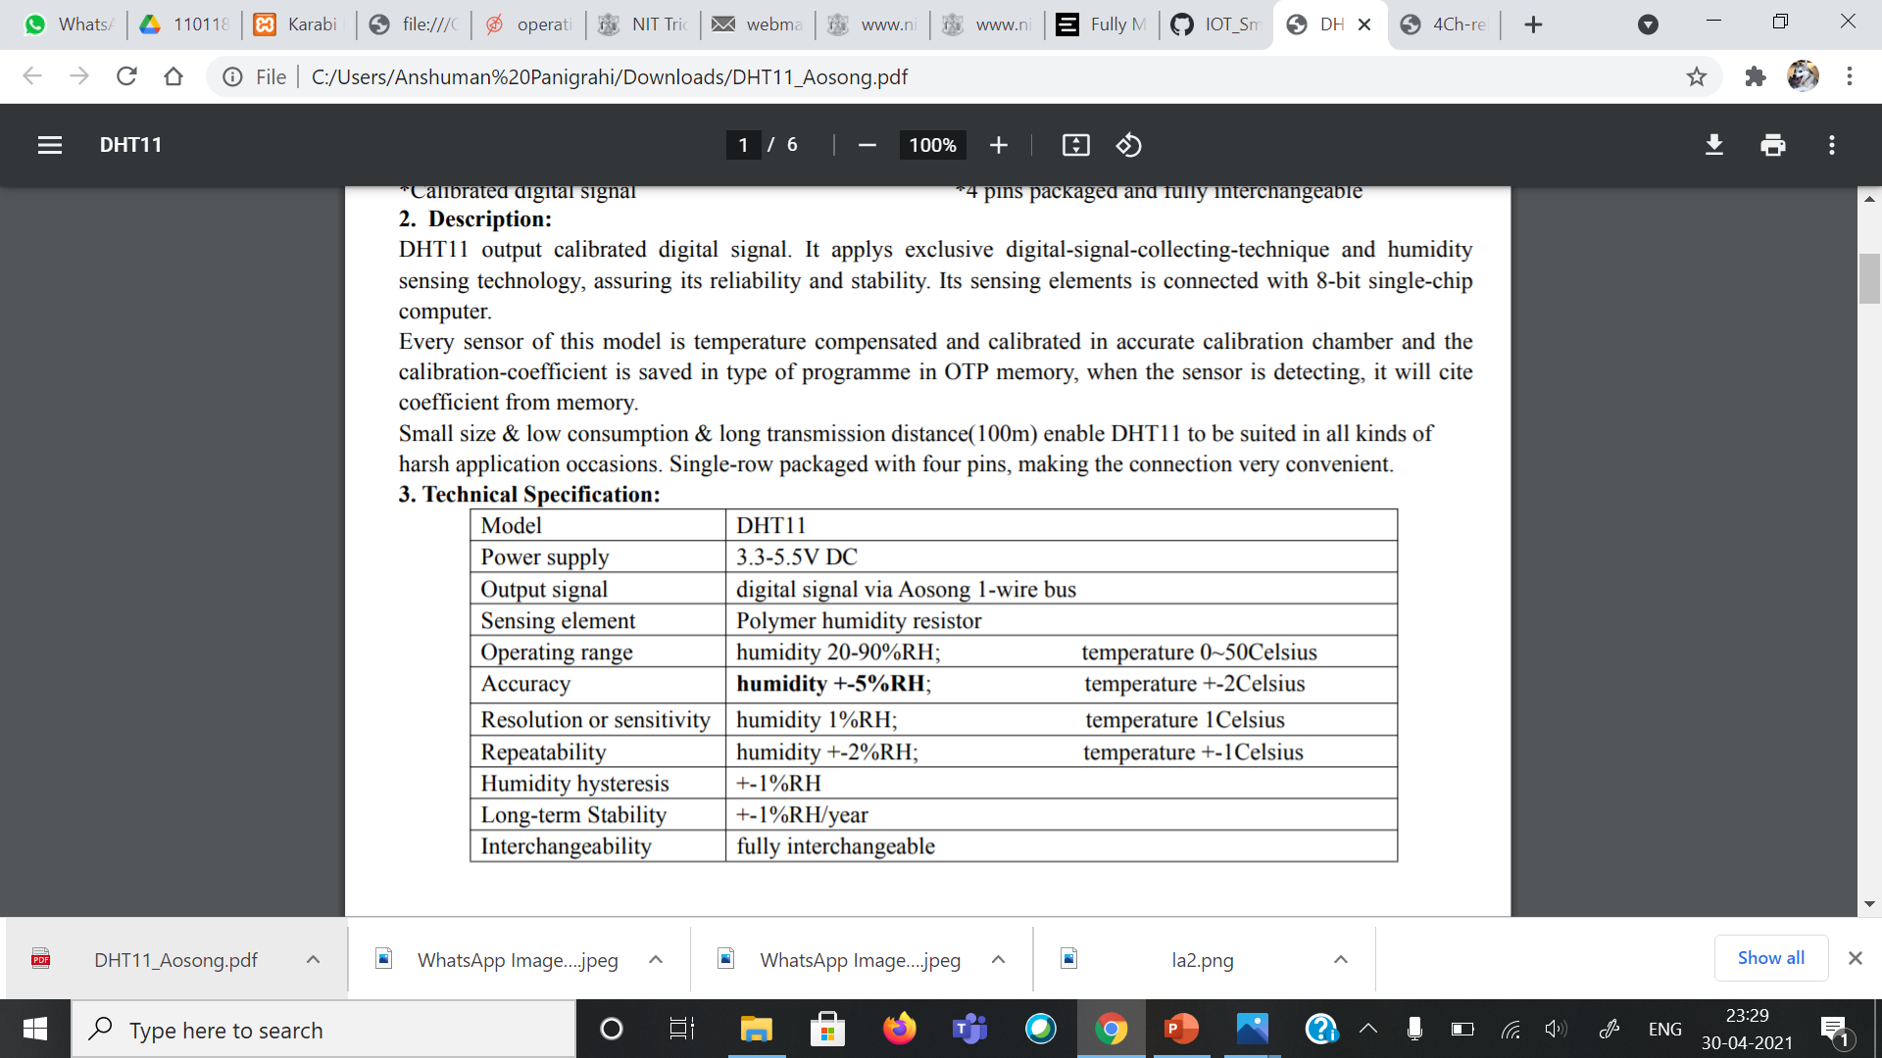
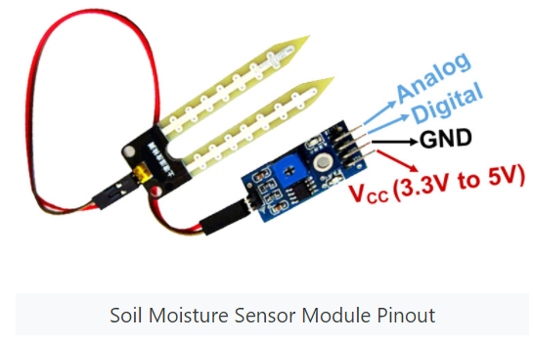
Humidity Sensor-DHT11(Aosong)
Techleads Soil Moisture Meter
Operating Voltage: 3.3V to 5V DC
Operating Current: 15mA
Output Digital - 0V to 5V, Adjustable trigger level from preset
Output Analog - 0V to 5V based on infrared radiation from fire flame falling on the sensor
LEDs indicating output and power
PCB Size: 3.2cm x 1.4cm
LM393 based design
Easy to use with Microcontrollers or even with normal Digital/Analog IC
Small, cheap and easily available

Slide 6
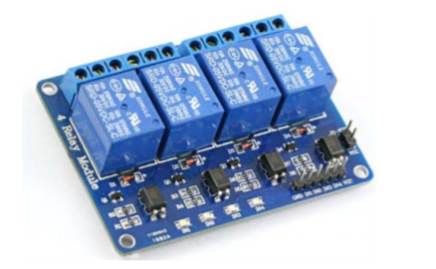
4 Channel 5V Optical Isolated Relay Module
This is a LOW Level 5V 4-channel relay interface board, and each channel needs a 15-20mA driver current. It can be used to control various appliances and equipment with large current. It has a standard interface that can be controlled directly by microcontroller. This module is optically isolated from high voltage side for safety requirement and also prevent ground loop when interface to microcontroller.
Brief Data:
• Relay Maximum output: DC 30V/10A, AC 250V/10A.
• 4 Channel Relay Module with Opto-coupler. LOW Level Trigger expansion board, which is compatible with Arduino control board.
• Standard interface that can be controlled directly by microcontroller ( 8051, AVR, *PIC, DSP, ARM, ARM, MSP430, TTL logic).
• Relay of high quality low noise relays SPDT. A common terminal, a normally open, one normally closed terminal
• Opto-Coupler isolation, for high voltage safety and prevent ground loop with microcontroller.

Slide 7
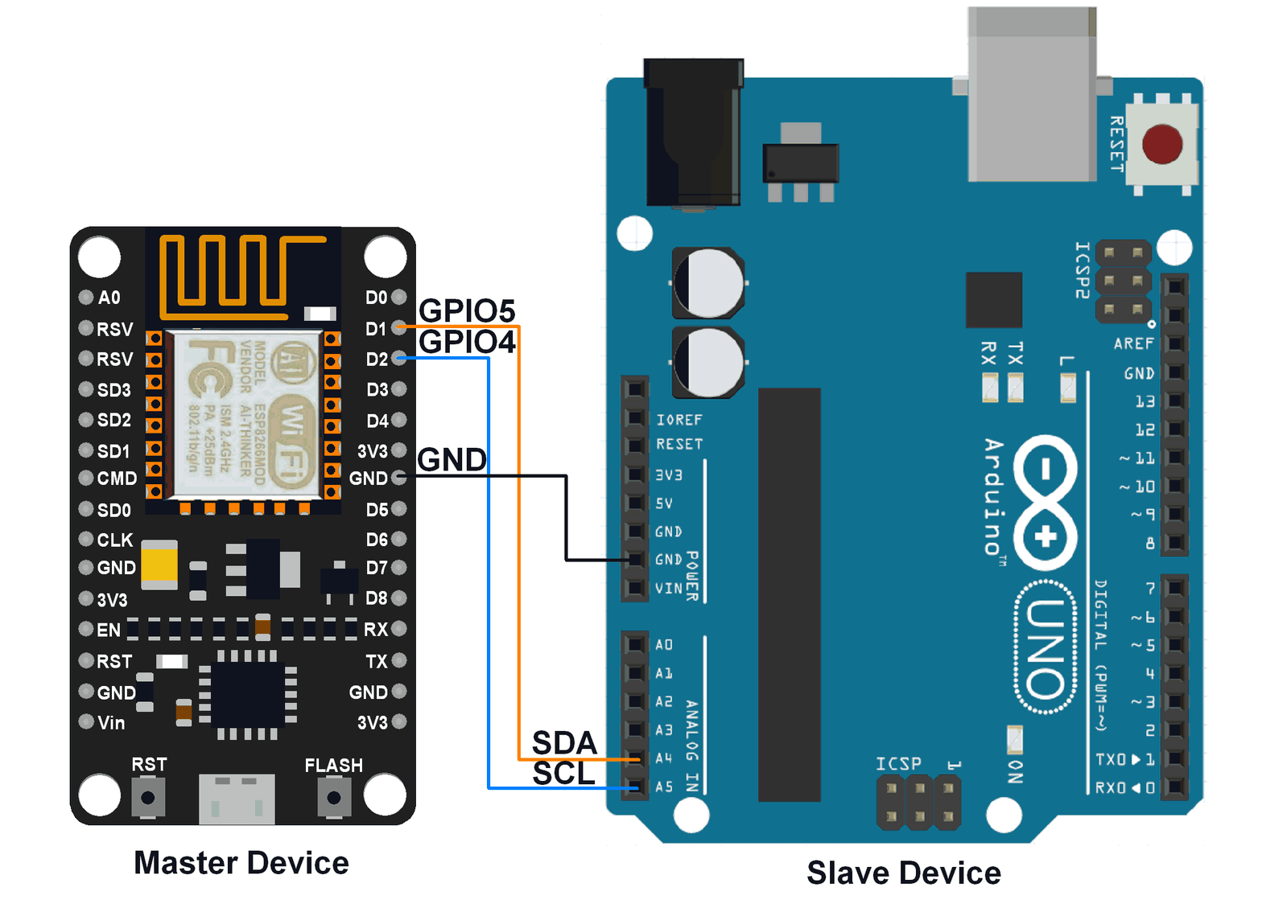
Arduino- NodeMCU ESP8266 I2C Interface

Slide 8
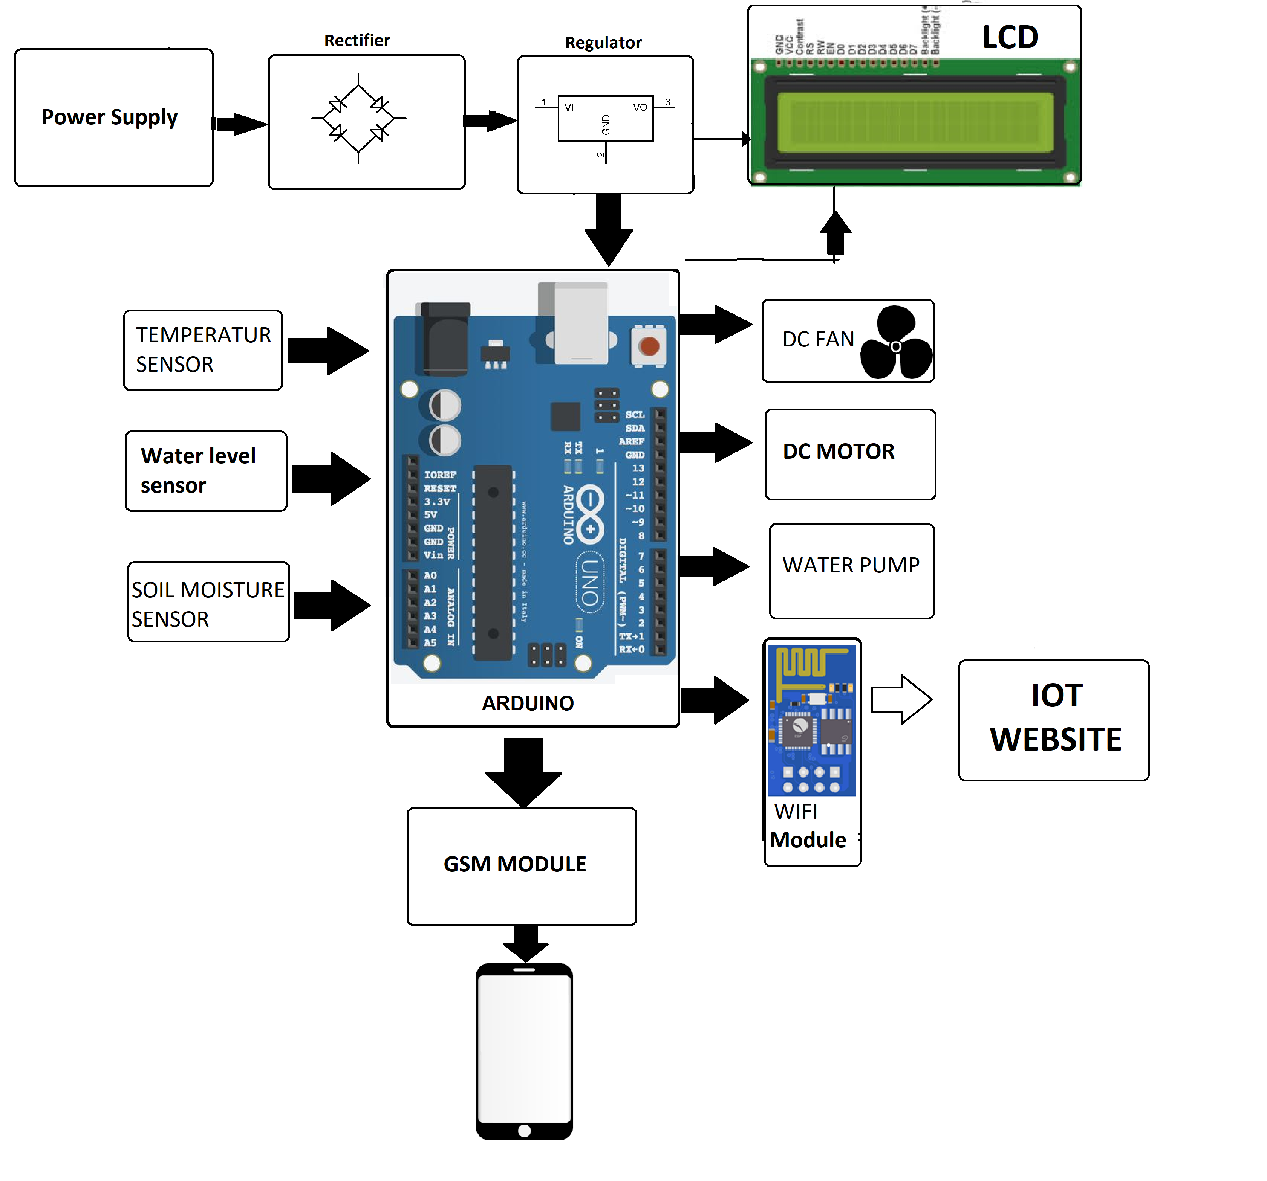
BLOCK DIAGRAM OF IOT SMART FARM

Slide 9
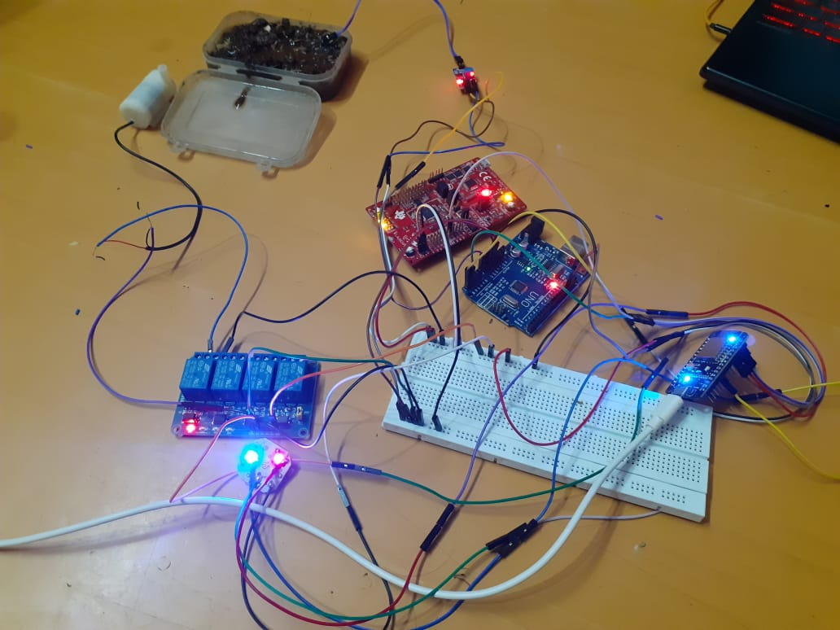
Working Circuit

Slide 10
About MQTT
With the advent of the 5G era, connecting everything is becoming a reality. Accessing a large number of devices and devices management brings a huge challenge to network broadband, communication protocol and platform service architecture.
MQTT protocol is an IoT messaging protocol based on the publish-subscribe model. It has occupied half of the IoT protocol because of its simple and easy to implement, supporting QoS and small packet.
setup EMQX broker
Client Info
Client can be any device. Laptop can be used with mqttx and phone can be used with apps on play store.
Topics
Humidity - Basically publish data of humidity from DTH11 Sensor
Temp - Publishes Temperature
Moisture - Publishes soil moisture
Water level - Publishes water level in tank

Slide 11
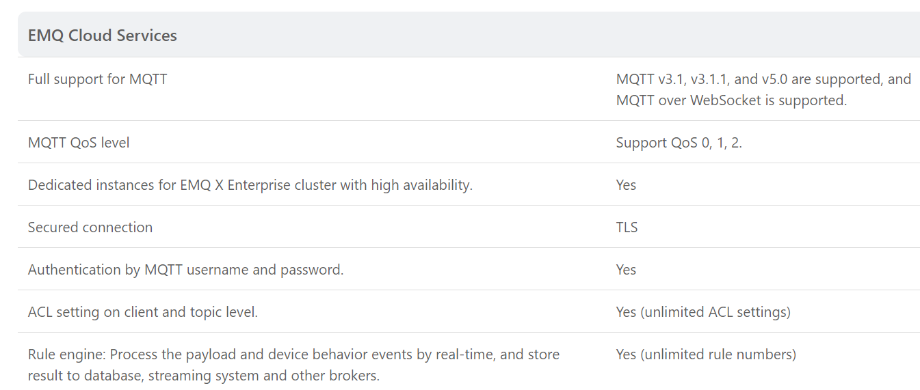
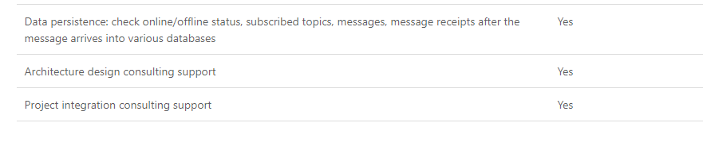
---Republish | Yes
— Bridge MQTT message to MQTT Broker | Yes
— Inspect (debug) | Yes
— Save data to WebServer | Yes
— Schema Registry | Yes
— Bridge MQTT message to Kafka | Yes
— Bridge MQTT message to RabbitMQ | Yes
— Bridge MQTT message to RocketMQ | Yes
— Bridge MQTT message to Pulsar | Yes
— Save data to PostgreSQL | Yes
— Save data to MySQL | Yes
— Save data to OpenTSDB | Yes
— Save data to Redis | Yes
— Save data to DynamoDB | Yes
— Save data to MongoDB | Yes
— Save data to InfluxDB | Yes
— Save data to Timescale | Yes
— Save data to Cassandra | Yes
Features of EMQX

Slide 12
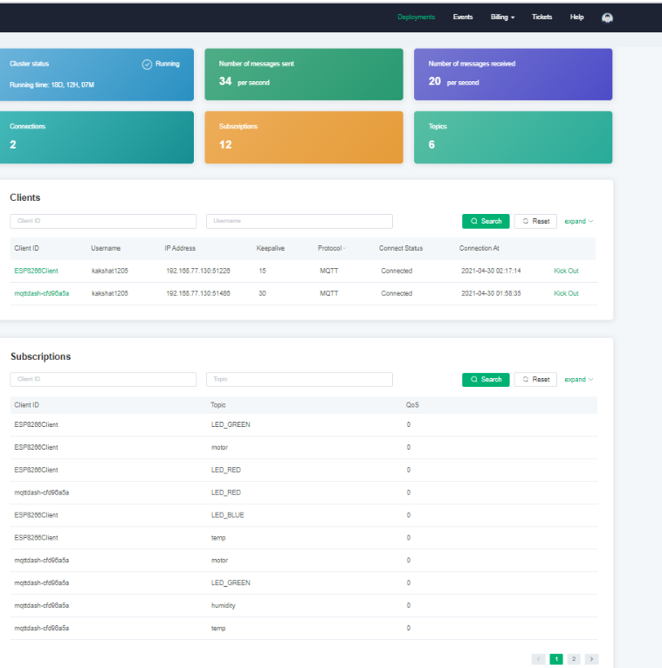
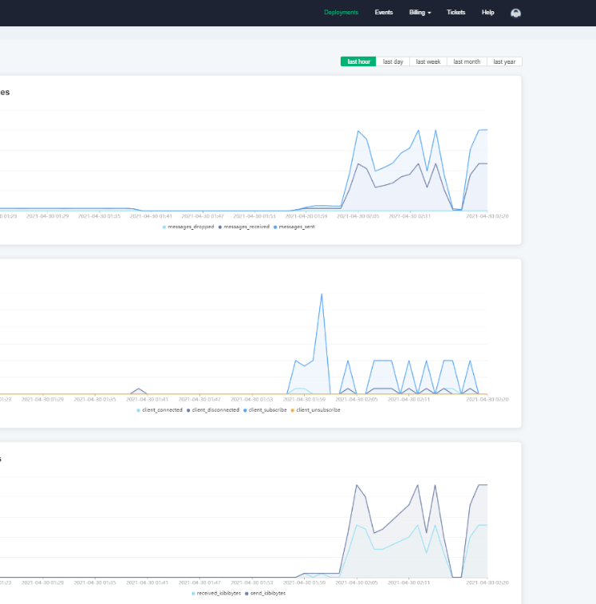

Slide 13
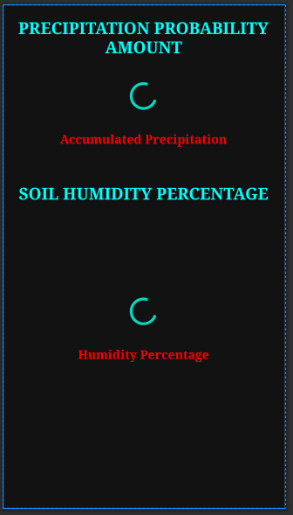
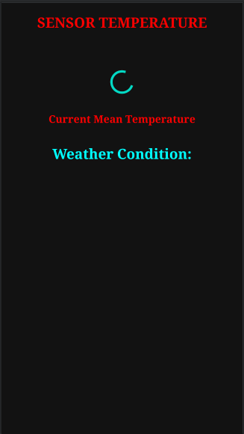
Android Application Building

Slide 14
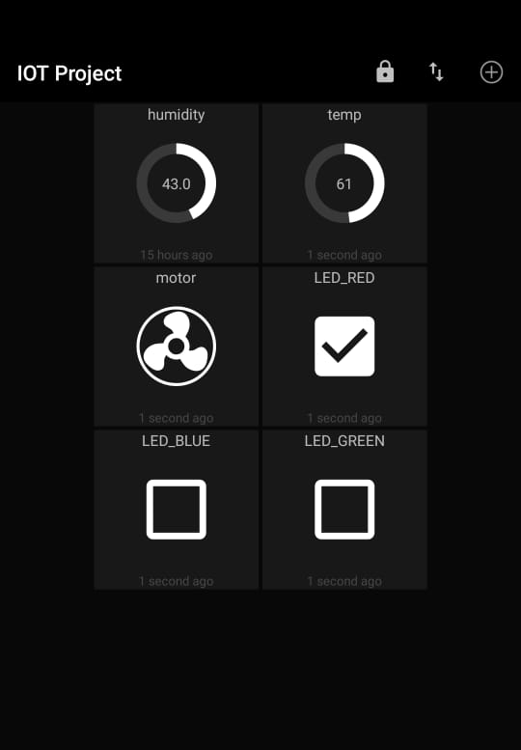
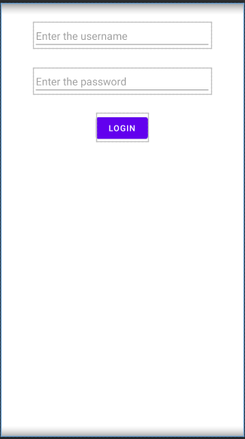

Slide 15
Current Progress
The model is working as expected, depending upon the soil moisture levels, it starts the water supply.
The analog data about humidity, temperature etc. is read and displayed in the android app in real time.

Slide 16

Notes:
5/1/2021
16
16

